Slide 1
Fundamentals of GenAI
PyTorch Primer - v2
Autograd and Sequential

Slide 2
PyTorch Autograd (autodiff) In a Nutshell
Text Similarity

Slide 3
PyTorch tensor attributes support gradient calculations
Tensor value(s), such that x == x.data
x = pt.tensor(...)
x.data
x.is_leaf = True
x.requires_grad = False
x.grad = None
x.grad_fn = None
True unless created from a tensor with requires_grad=True
False when is_leaf = True
Gradient value if exists
Function that knows how to perform backward()

Slide 4
PyTorch disables tensor autodiff (autograd) by default

Slide 5

Demo
Text Similarity
PyTorch AutoGrad
Experiment with autograd

Slide 6
Demo
Text Similarity
PyTorch AutoGrad
Experiment with autograd

Slide 7
Layers

Slide 8
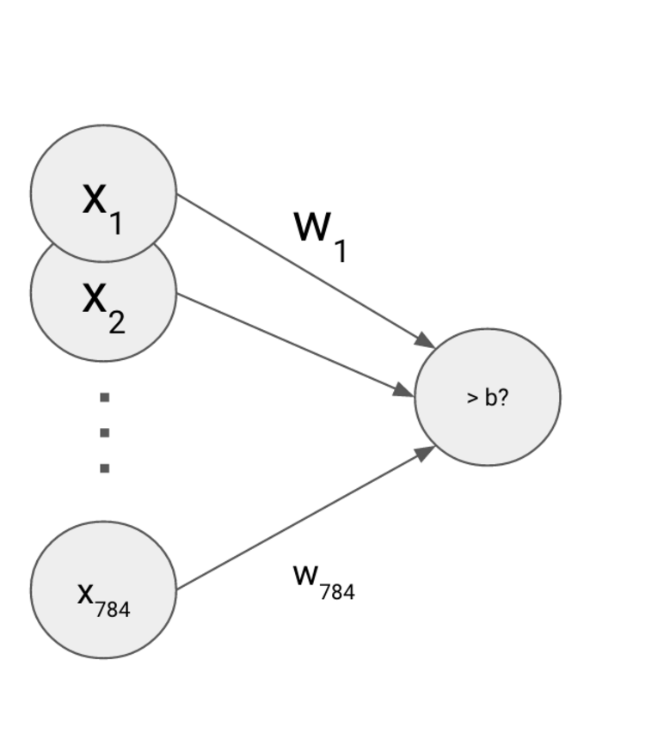
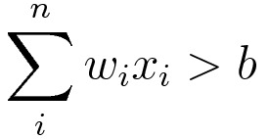
Many-to-one, as well as fully-connected
many-to-many
Available Layers:
Linear
Convolution
Padding
Pooling
Normalization
Dropout
Recurrent
Embedding

Slide 9
nn.Linear() is a fully connected layer, every input to every output
Bias by default
from torch import nn
model = nn.Linear(#_inputs, #_outputs,
bias = True)
model.parameters()
model.weight, model.bias
model.zero_grad()
model.weight.grad, model.bias.grad
model(X)
Weights & bias
Zero out gradients
Access gradient values
forward()

Slide 10
Exercise
Text Similarity
Binary Classifier with nn.Linear
Use the nn package

Slide 11
To read sharded CSV files, use Pandas concat and then decode the CSV into features and targets for the training TensorDataset
from torch.utils.data import TensorDataset
df = pd.concat(
pd.read_csv(file) for file in Path('data/').glob('part-*.csv')
)
...
X = pt.tensor(train_df[FEATURES].values)
y = pt.tensor(train_df[TARGET].values)
train_ds = TensorDataset(y, X)

Slide 12
TensorDataset is used to instantiate an enumerable DataLoader, which supports data batching and indexing
from torch.utils.data import DataLoader
train_ds = TensorDataset(y, X)
train_dl = DataLoader(train_ds, batch_size=BATCH_SIZE)
for epoch in range(EPOCHS):
for batch_idx, batch in enumerate(train_dl):
y, X = batch

Slide 13
Exercise
Text Similarity
Dataset and DataLoaders
Use the data package

Slide 14
torch.nn.Sequential helps organize neural nets with many layers
model = nn.Sequential(
nn.Linear(5, 5),
nn.ReLU(),
nn.Linear(5, 5),
nn.ReLU(),
nn.Linear(5, 5)
)
model(X)

Slide 15
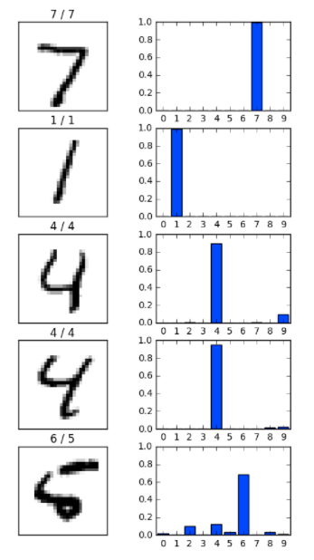
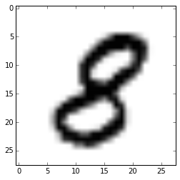
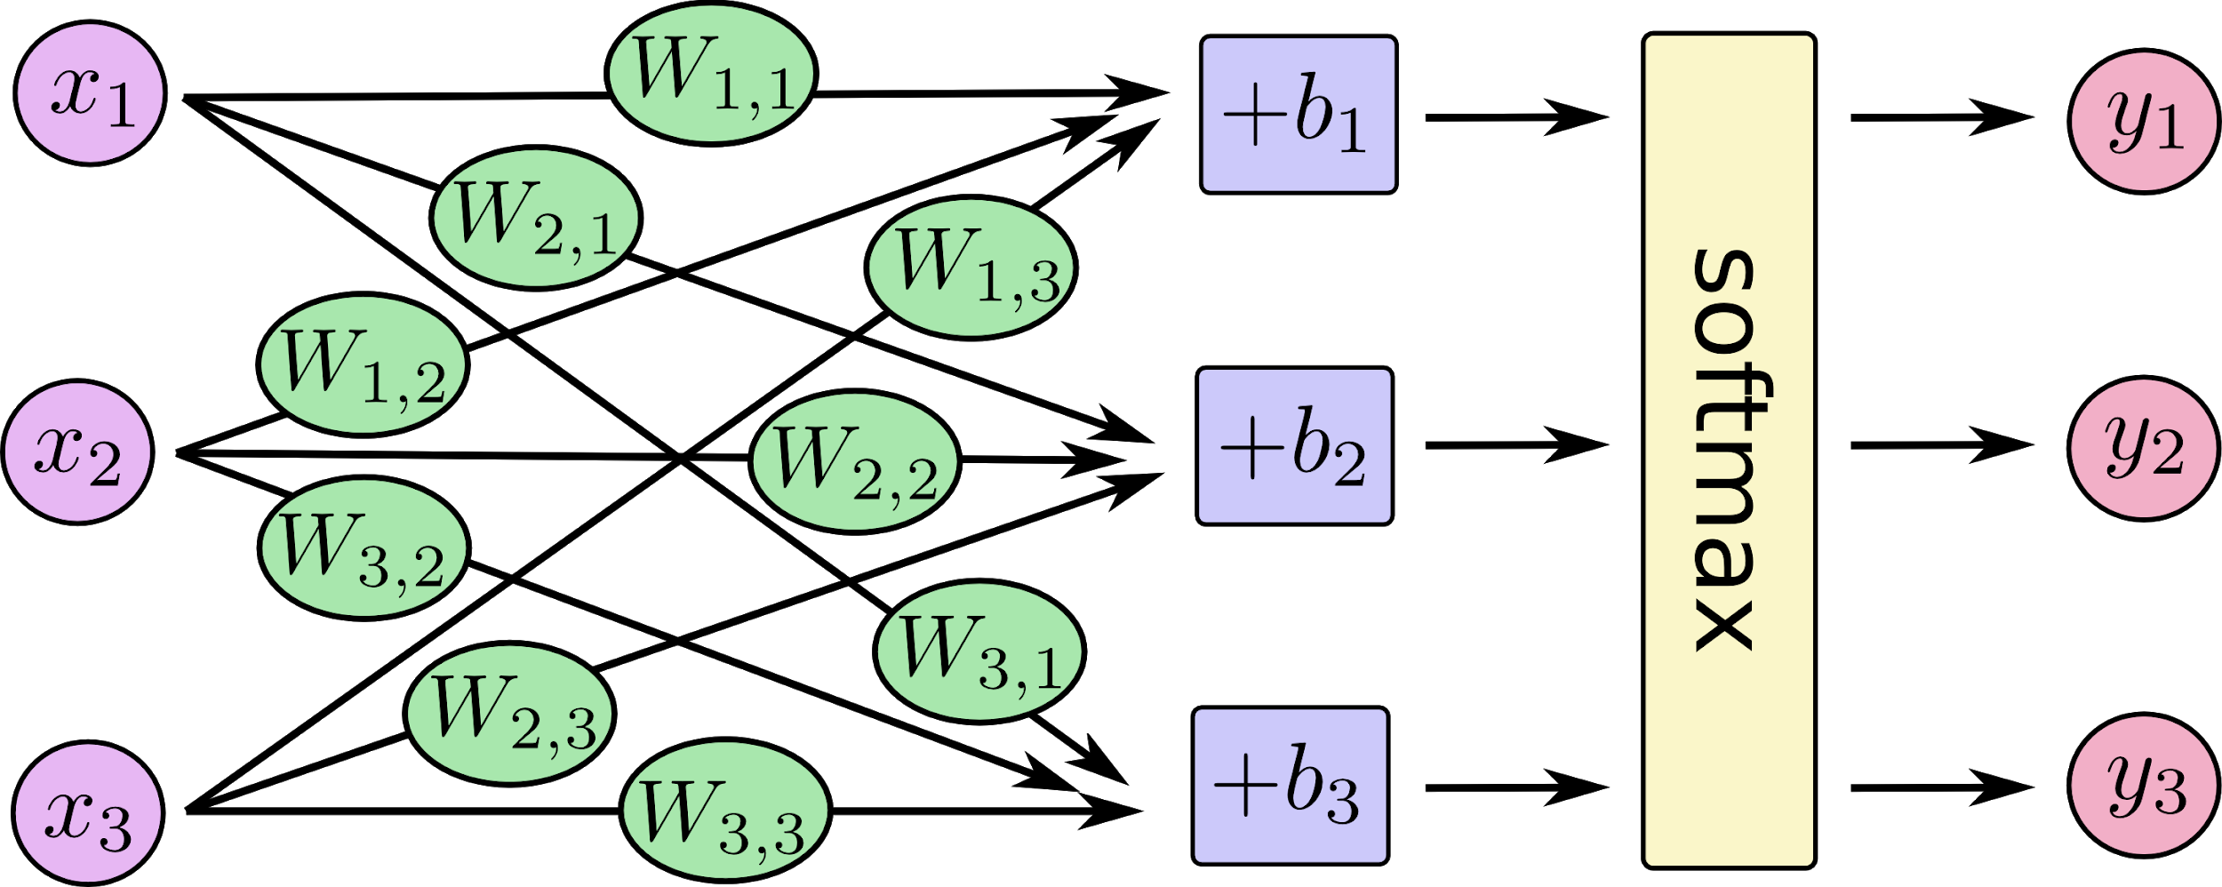
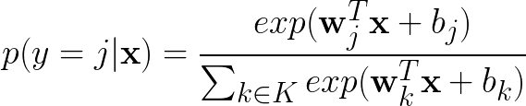
Softmax helps deal with non-binary (multivariate) target values
output vector (probability
estimate)
input vector
(pixel data)

Slide 16
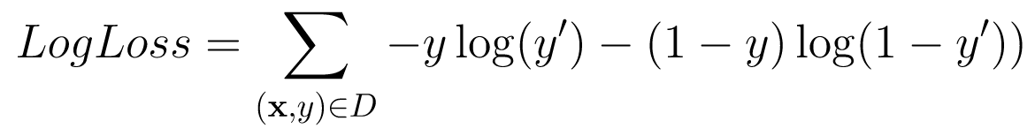
torch.nn.functional.log_softmax() + nll_loss() = cross_entropy()
Negative log likelihood is the loss for softmax outputs

Slide 17
Demo
Text Similarity
Sequential Networks
Use nn.Sequential

Slide 18
Lab
Text Similarity
Sequential Networks
Use nn.Sequential

